Slide 1

email spam detection using machine learning algorithm
Guide: Dr.m.seshashayee By:Pilli Mounika Devi
Associate Professor VP21CSCI0200101
Msc Data Science

Slide 2
Contents
Abstract 10. Existing System
Introduction 11. Proposed System and Architecture
Problem Statement 12. Results
Aim 13. Conclusions
Objective 14. References
Modules Description
Diagrams
Design

Slide 3
ABSTRACT
Email Spam has become a major problem nowadays, with Rapid growth of internet users, Email spams is also increasing. People are using them for illegal and unethical conducts, phishing and fraud. Sending malicious link through spam emails which can harm our system and can also seek in into your system. Creating a fake profile and email account is much easy for the spammers, they pretend like a genuine person in their spam emails, these spammers target those peoples who are not aware about these frauds.
So, it is needed to Identify those spam mails which are fraud, this project will identify those spam by using techniques of machine learning, this paper will discuss the machine learning algorithms and apply all these algorithm on our data sets and best algorithm is selected for the email spam detection having best precision and accuracy .svm,RandomForest,Knn and ensemble classifiers are proposed in our system

Slide 4
INTRODUCTION
Spam refers to an email aimed manipulating an individual to whom it is aimed at or just randomly flooding the inbox. It is also called as junk mail and it floods Internet clients Inboxes.
Today spam emails are of a variety of types ranging from ads to business promoting to doubtful products to some objectionable services.
Therefore it is difficult to identify and classify an email as spam or non-spam.
Additionally, the commercial world has significant interests in spam detection because spam causes loss of work productivity and financial loss.

Slide 5
It is estimated that American firms and consumers lose 20 billion annually, even while sustained by the private firms’ investment in anti-spam software.
On the other hand, spam advertising earns 200 million per year. Although extensive work has been done on spam filter improvement over the years, many of the spam filters today have limited success because of the dynamic nature of spam.
Spammers are constantly developing new techniques to bypass filters, some of which include word obfuscation and statistical poisoning.
Naïve Bayes is very accurate; however, it is unable to correctly classify emails when they contain leetspeak or diacritics.
Thus in this proposes, we implemented a novel algorithm for enhancing the accuracy of the Naive Bayes Spam Filter so that it can detect text modifications and correctly classify the email as spam or ham.

Slide 6
PROBLEM STATEMENT
Most of us consider spam emails as one which is annoying and repetitively used for purpose of advertisement and brand promotion. We keep on blocking such email-ids but it is of no use as spam emails are still prevalent.
Some major categories of spam emails that are causing great risk to security, such as fraudulent e-mails, identify theft, hacking, viruses, and malware.
In order to deal with spam emails, we need to build a robust real-time email spam classifier that can efficiently and correctly flag the incoming mail spam, if it is a spam message or looks like a spam message

Slide 7
AIM
There is a great scope in building email spam classifiers, as the private companies run their own email servers and want them to be more secure because of the confidential data, in such cases email spam classifier solutions can be provided to such companies.

Slide 8
OBJECTIVE
Achieve High Accuracy: Develop a spam detection system that can achieve high accuracy rates in detecting spam emails while minimizing false positives and negatives.
Reduce Spam Emails: Reduce the number of unwanted and malicious emails that users receive, improving their email experience and productivity.
Enhance Security: Improve the security of the email system by reducing the risk of phishing attacks, malware, and other email-based threats.
Real-time Detection: Develop a system that can detect spam emails in real-time, without any noticeable delays or performance issues.
Easy-to-use: Create a system that is easy to use and requires minimal user intervention or configuration.
Maintenance: Develop a system that is easy to maintain and update over time, with regular software updates and bug fixes.

Slide 9
MODULES DESCRIPTION
MODULE 1
Email Spam Detection using integrated approach of Naïve Bayes and Particle Swarm Optimization
Naïve Bayes algorithm is a Bayes theorem based statistical machine learning based approach having properties of strong independence, probability distribution and ability to handle large datasets. ➢ In NB, probability distribution is evaluated from the frequency distribution of dataset.
Particle Swarm Optimization (PSO) is swarm intelligence based concept derived in 1995 by Eberhart and Kennedy
PSO work on the property of stochastic distribution and initially find the local search solution, then individual particle share their solution and global solution is obtained.

Slide 10
MODULE 2
Email Spam Classification by Support Vector Machine
This paper uses Support Vector Mechanism algorithm to identify spam emails.
Descriptions as provided on Spam Assassin website for the dataset used in this paper.
SVM is also considered as an important kernel methods, which is one of the most important areas in machine learning concepts.
Smart Traffic Control System with Application of Image Processing Techniques

Slide 11
MODULE 3
Intelligent Model for Classification of SPAM and HAM
In this paper they have used machine learning and non machine learning approaches.
Machine learning approaches like support vector mechanism, neural network etc. Non machine learning approaches like strong key word searching and whitelisting and blacklisting of words.
The sets so formed are further used as training set and the classification set.
The process is to use the first set as training set and the remaining N-1 sets as the sets to be classified.

Slide 12
Design

Slide 13
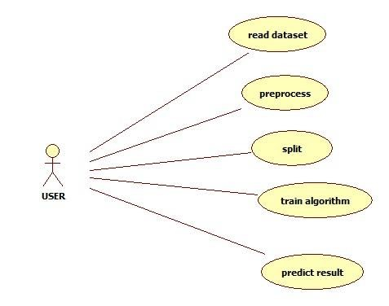
USE CASE DIAGRAM
. The main purpose of a use case diagram is to show what system functions are performed for which actor. Roles of the actors in the system can be depicted.

Slide 14
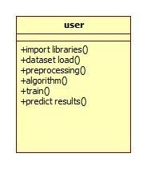
CLASS DIAGRAM
In software engineering, a class diagram in the Unified Modeling Language (UML) is a type of static structure diagram that describes the structure of a system by showing the system's classes, their attributes, operations (or methods), and the relationships among the classes. It explains which class contains information

Slide 15
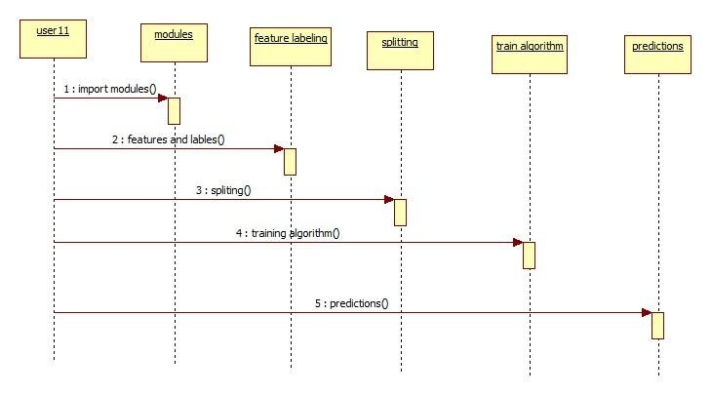
SEQUENCE DIAGRAM A sequence diagram in Unified Modeling Language (UML) is a kind of interaction diagram that shows how processes operate with one another and in what order. It is a construct of a Message Sequence Chart. Sequence diagrams are sometimes called event diagrams, event scenarios, and timing diagrams.

Slide 16
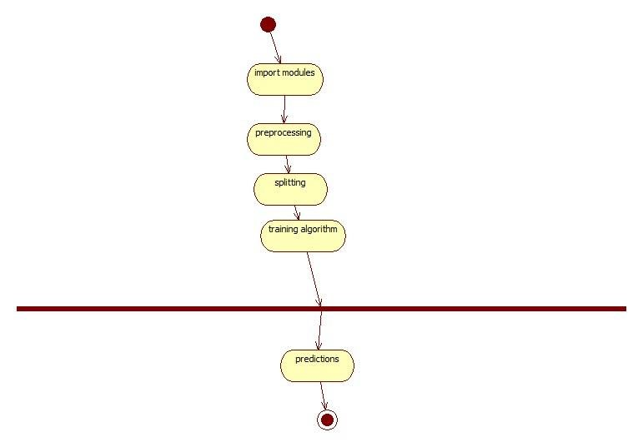
ACTIVITY DIAGRAM
Activity diagrams are graphical representations of workflows of stepwise activities and actions with support for choice, iteration and concurrency. In the Unified Modeling Language, activity diagrams can be used to describe the business and operational step-by-step workflows of components in a system. An activity diagram shows the overall flow of control .

Slide 17
Existing System
There is some related work that apply machine learning methods in email spam detection,of a A. Karim, S. Azam,B. Shanmugam, K. Kannoorpatti and M. Alazab. They describe a focused literature survey of Artificial Intelligence Revised (AI) and Machine learning methods for email spam detection. Agarwal and T. Kumar. Harisinghaney et al. (2014) and Mohamad & Selamat (2015) have used the “image and textual dataset for the e-mail spam detection with the use of various methods. Harisinghaney et al. ( 2014) have used methods of KNN isalgorithm, Naïve Bayes, and Reverse DBSCAN algorithm with experimentation on dataset. For the text recognition, OCR library” is employed but this OCR doesn’t perform well. Mohamad & Selamat (2015) uses the feature selection hybrid approach of TF-IDF (Term Frequency Inverse Document Frequency) and Rough pure mathematics.

Slide 18
Proposed System
In this proposed system, a dataset from “Kaggle” website is used as a training dataset. The inserted dataset is first checked for duplicates and null values for better performance of the machine. Then, the dataset is split into 2 sub-datasets; say “train dataset” and “test dataset” in the proportion of 70:30. Then the “train” and “test” dataset is then passed as parameters for text-processing. In text-processing, punctuation symbols and words that are in the stop words list are removed and returned as clean words. These clean words are then passed for “Feature Transform”. In feature transform, the clean words which are returned from the text-processing are then used for ‘fit’ and ‘transform’ to create a vocabulary for the machine

Slide 19
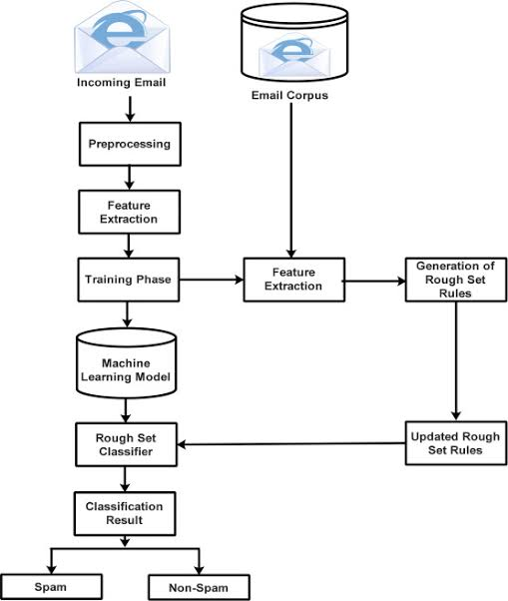
Proposed System Architecture

Slide 20
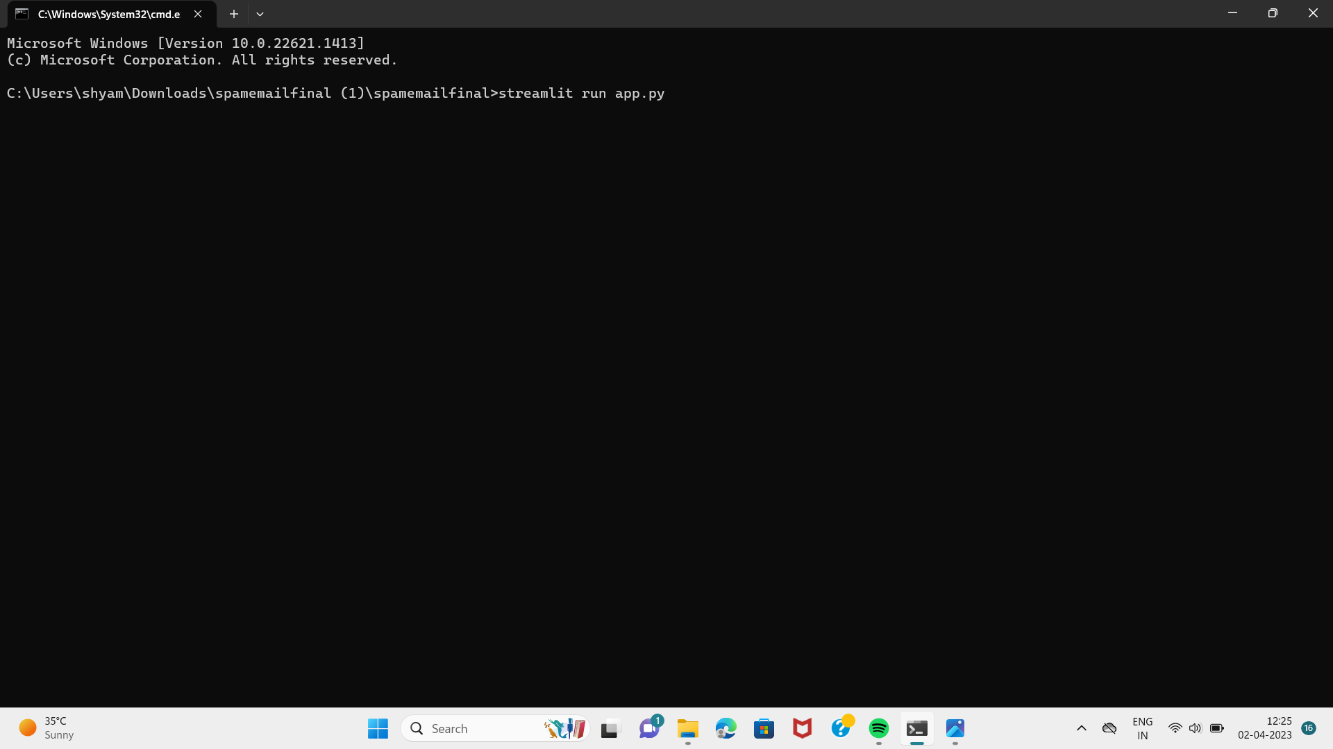
Results
Main Page

Slide 21
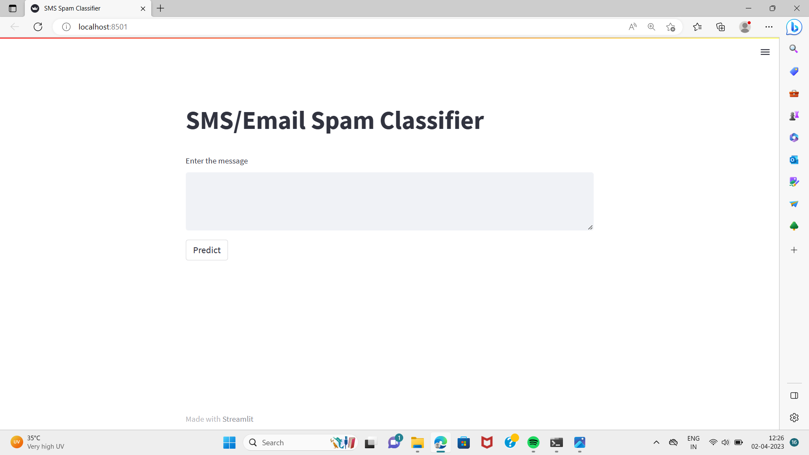
Home page

Slide 22
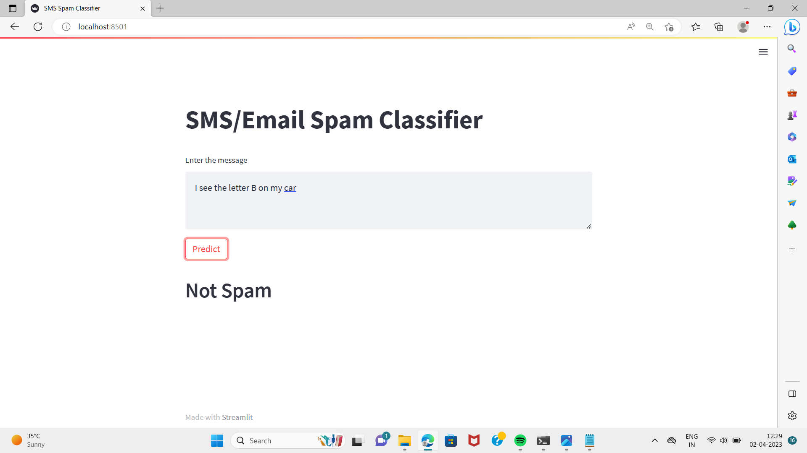
Output

Slide 23
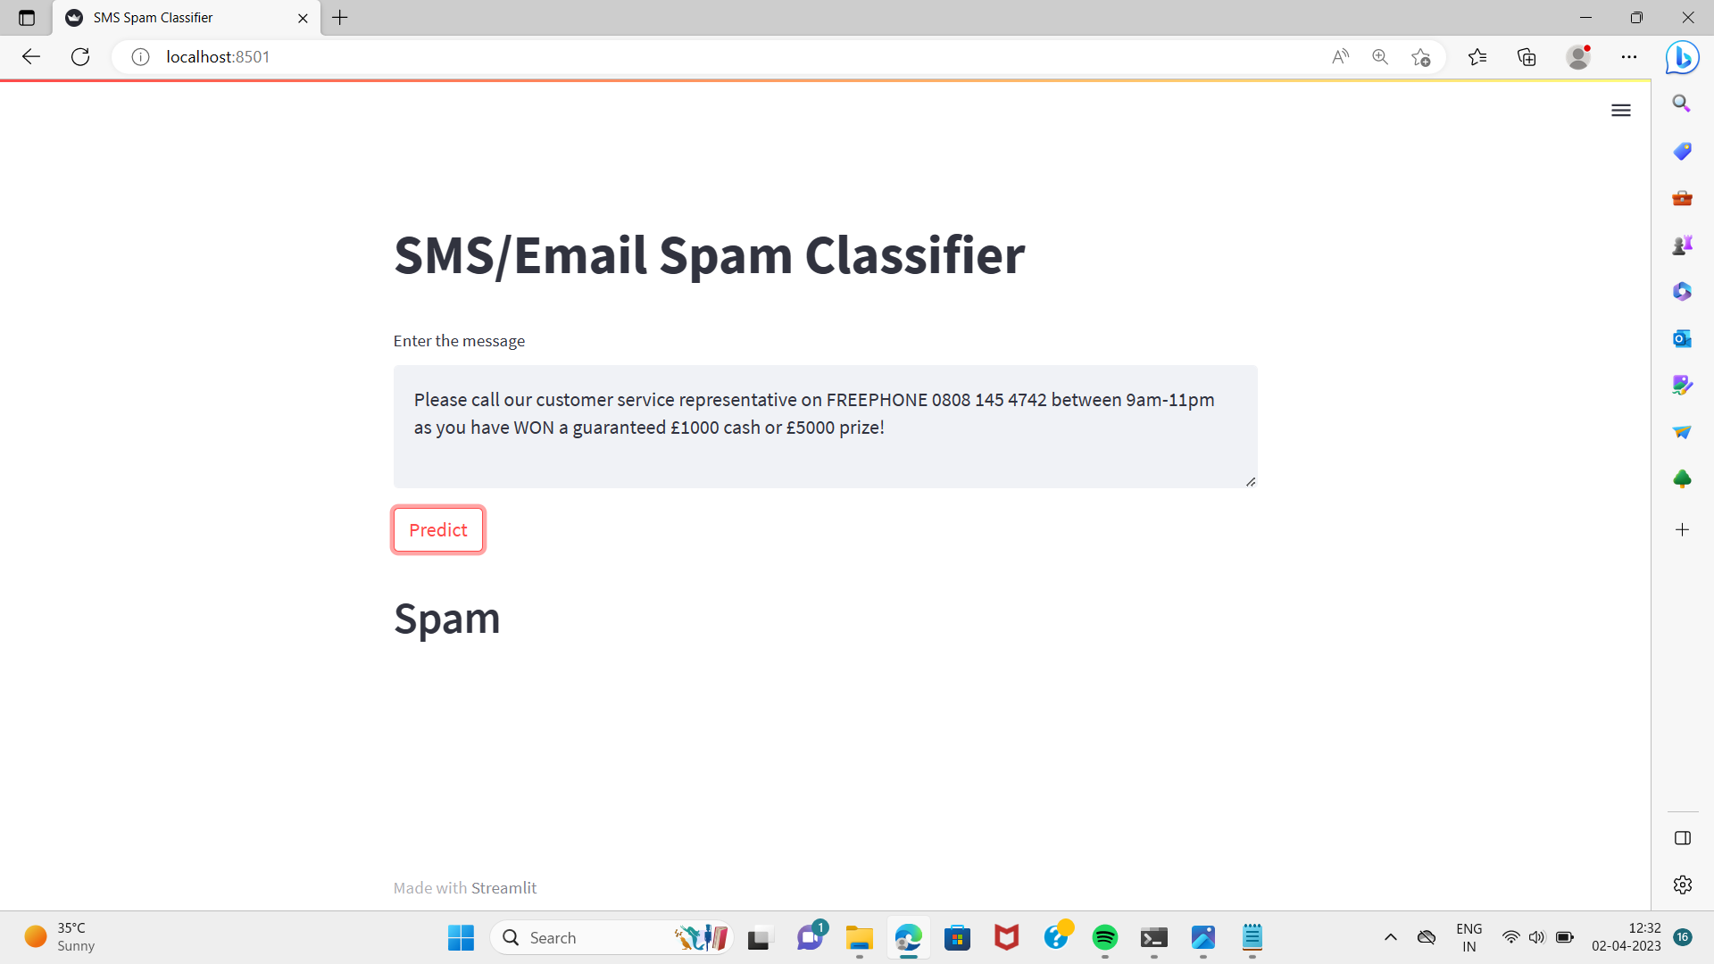

Slide 24
Conclusions
We proposed a novel algorithm for enhancing the accuracy of the Naive Bayes Spam Filter. The algorithm was implemented as an enhancement for Naive Bayes Classifier and also tested with logistic regression model. Naive Bayes has a very fast processing speed and allows for a small training set, hence is suitable for real-time spam filtering. We are also using Intelligent Text Modification method to identify messages containing leetspeak and diacritic. We are able to classify email as spam or ham. By creating an addition to Naive Bayes Classifier. We also found that our new addition helped improve ham classification due to the high recall and precision rates. We demonstrated that our algorithm consistently reduced the amount of spam emails misclassified as ham email.

Slide 25
References
Email Spam Detection using integrated approach of Naïve Bayes and Particle Swarm Optimization
[1] Email Spam Classification by Support Vector Machine
[2] Intelligent Model for Classification of SPAM and HAM
[3] Team, Radicati. "Email Statistics Report, 2015-2019. The Radicati Group." (2015).

Slide 26
[4] Androutsopoulos I., J. Koutsias, K. V. Chandrinos, G. Paliouras,and C. D. Spyropoulos, "An evaluation of naive bayesian antispam filtering", In: 11th European Conference on Machine Learning, pp.9-17, Barcelona, Spain, 2000.
[5] GitHub, Inc, "Spam Assassin," 21 April 2016. [Online]. Available: https://github.com/dmitrynogin/SpamAssassin.git. [Accessed 20 August 2017]

Slide 27
THANK YOU

